Slide 1
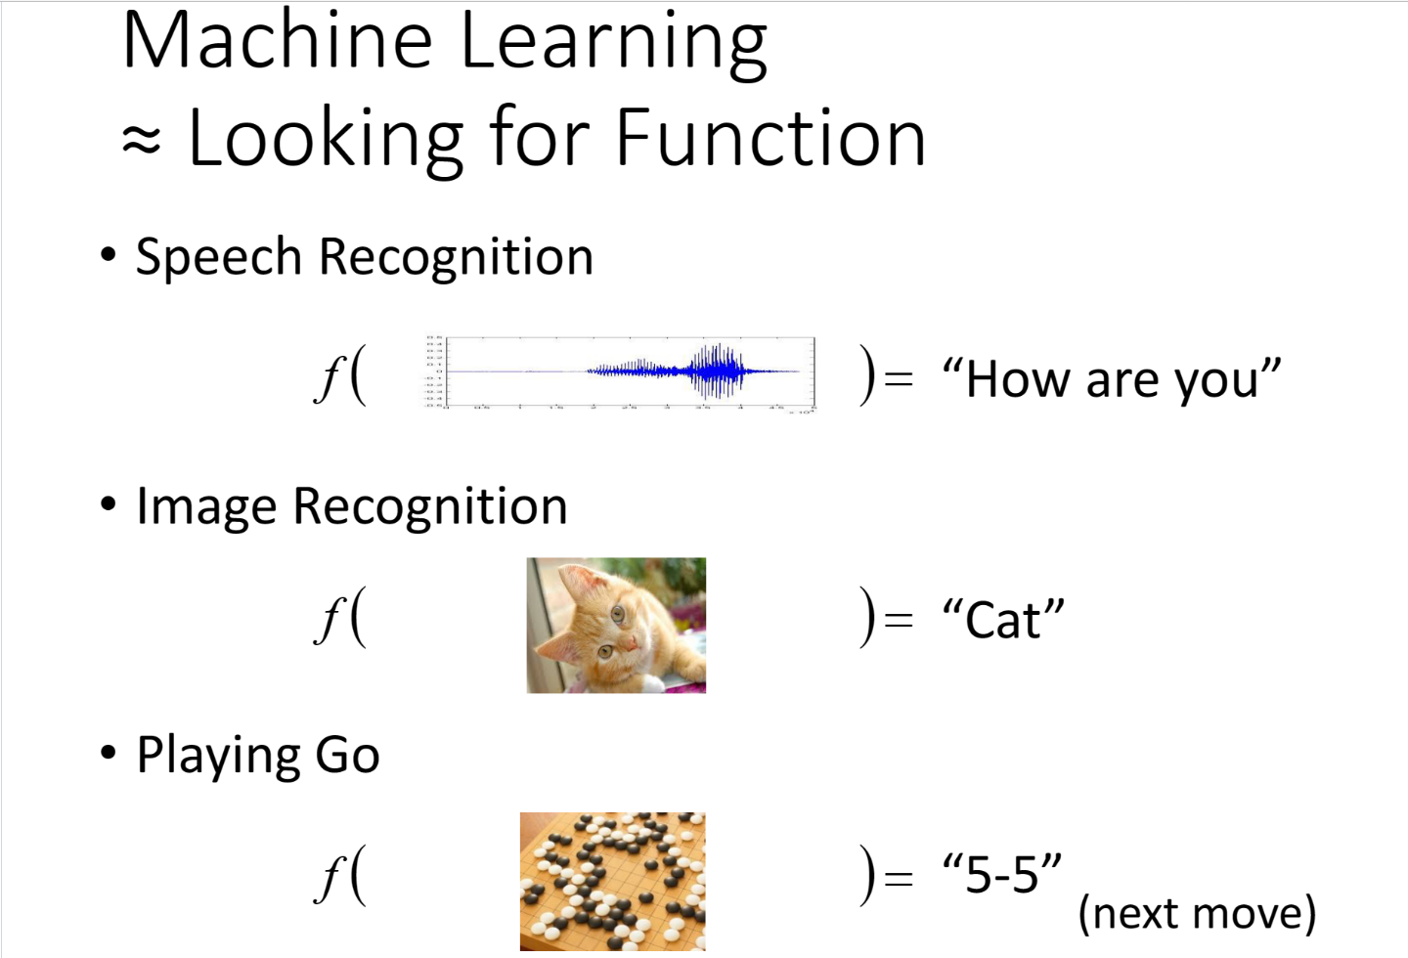

Slide 2
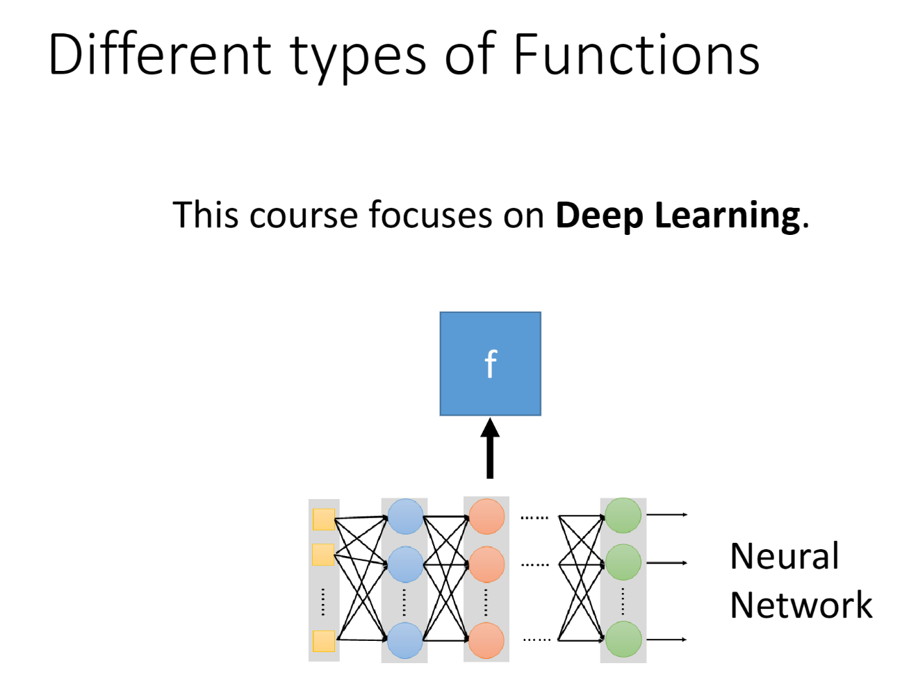

Slide 3
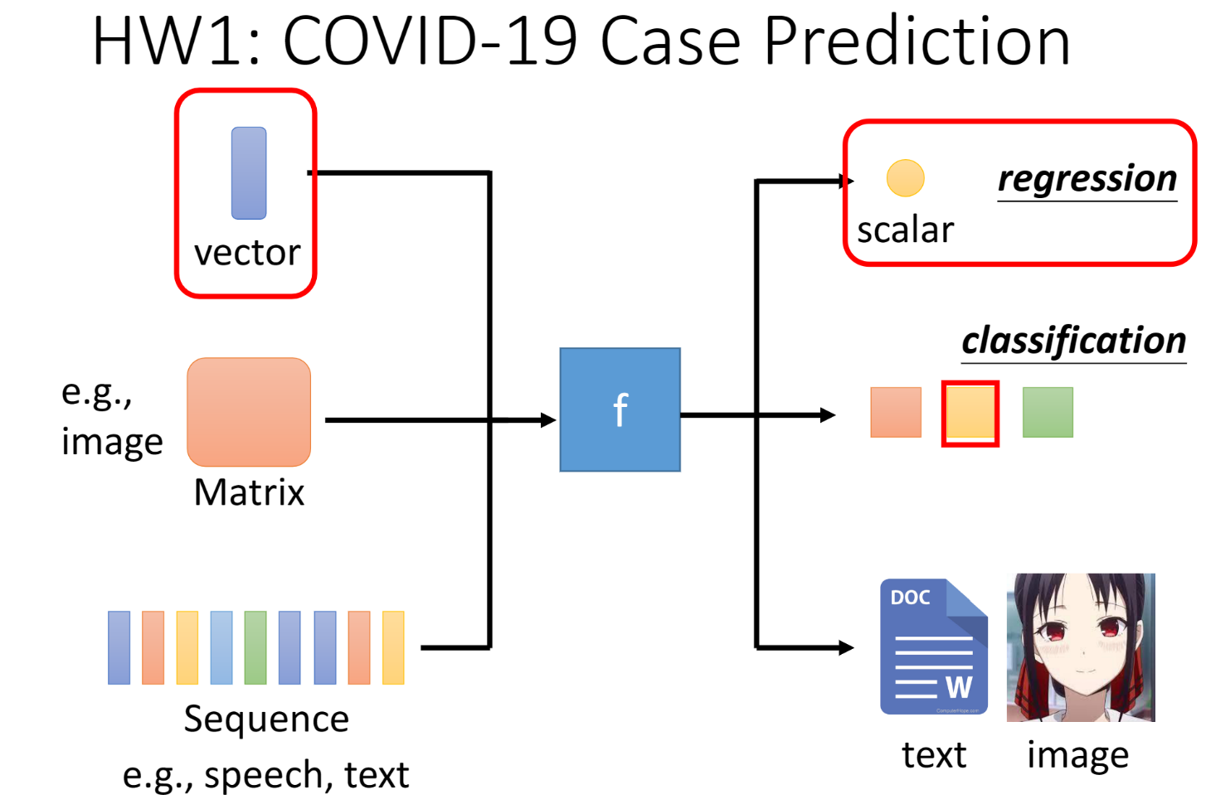

Slide 4
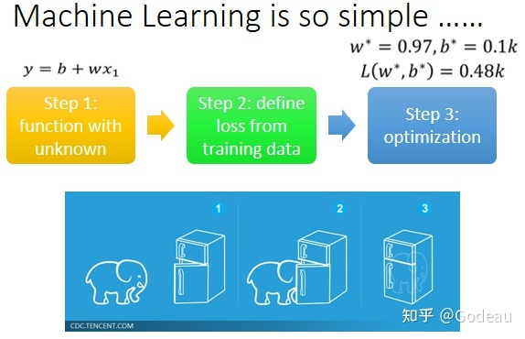

Slide 5
What does the code do?
1. Load data——Dataset and Data Loader
2. Building nnModel (Function Set) —— nn.Module
3. Define loss and optimization—— trainer
4. Train
5. Visualize and predict
Y = w*x + b

Slide 6
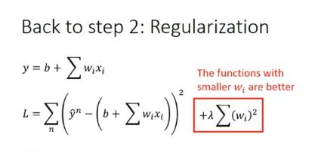
TODOs
# TODO: modify model's structure, be aware of dimensions.
# TODO: Select suitable feature columns.
# TODO: Please check https://pytorch.org/docs/stable/optim.html to get more available algorithms.
# TODO: L2 regularization (optimizer(weight decay...) or implement by your self).
L2 regularization: change weight_decay

Slide 7
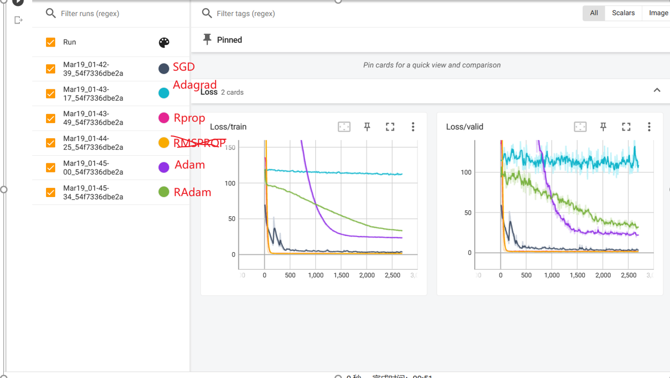

Slide 8
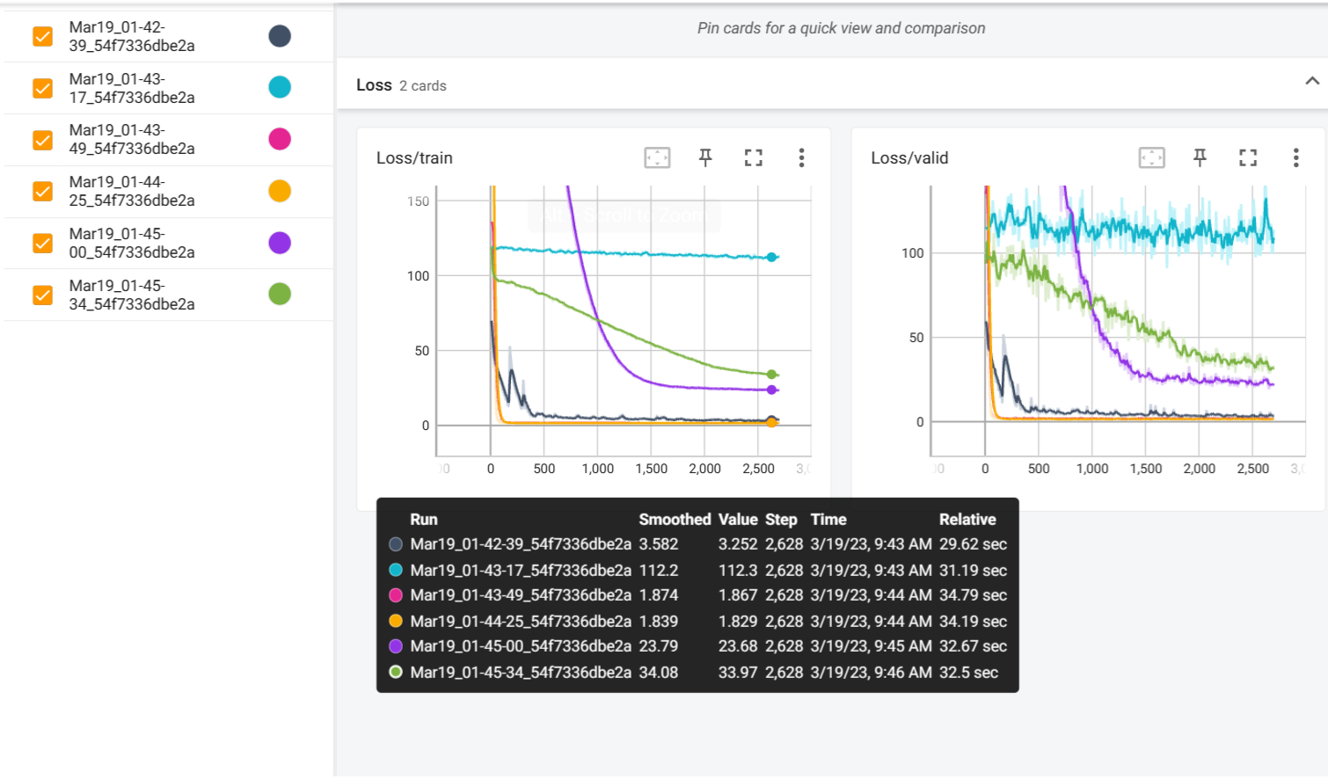

Slide 9
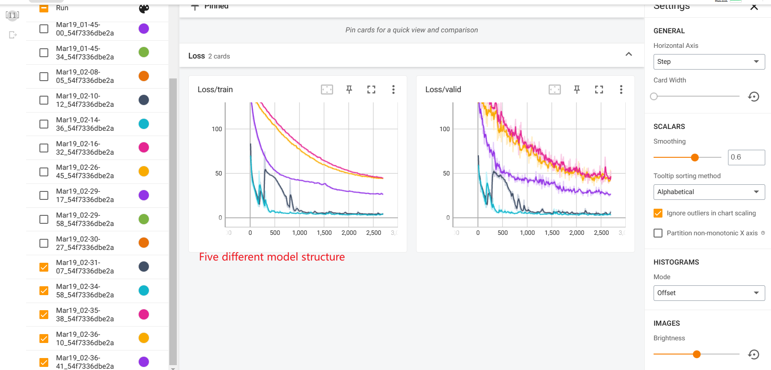

Slide 10
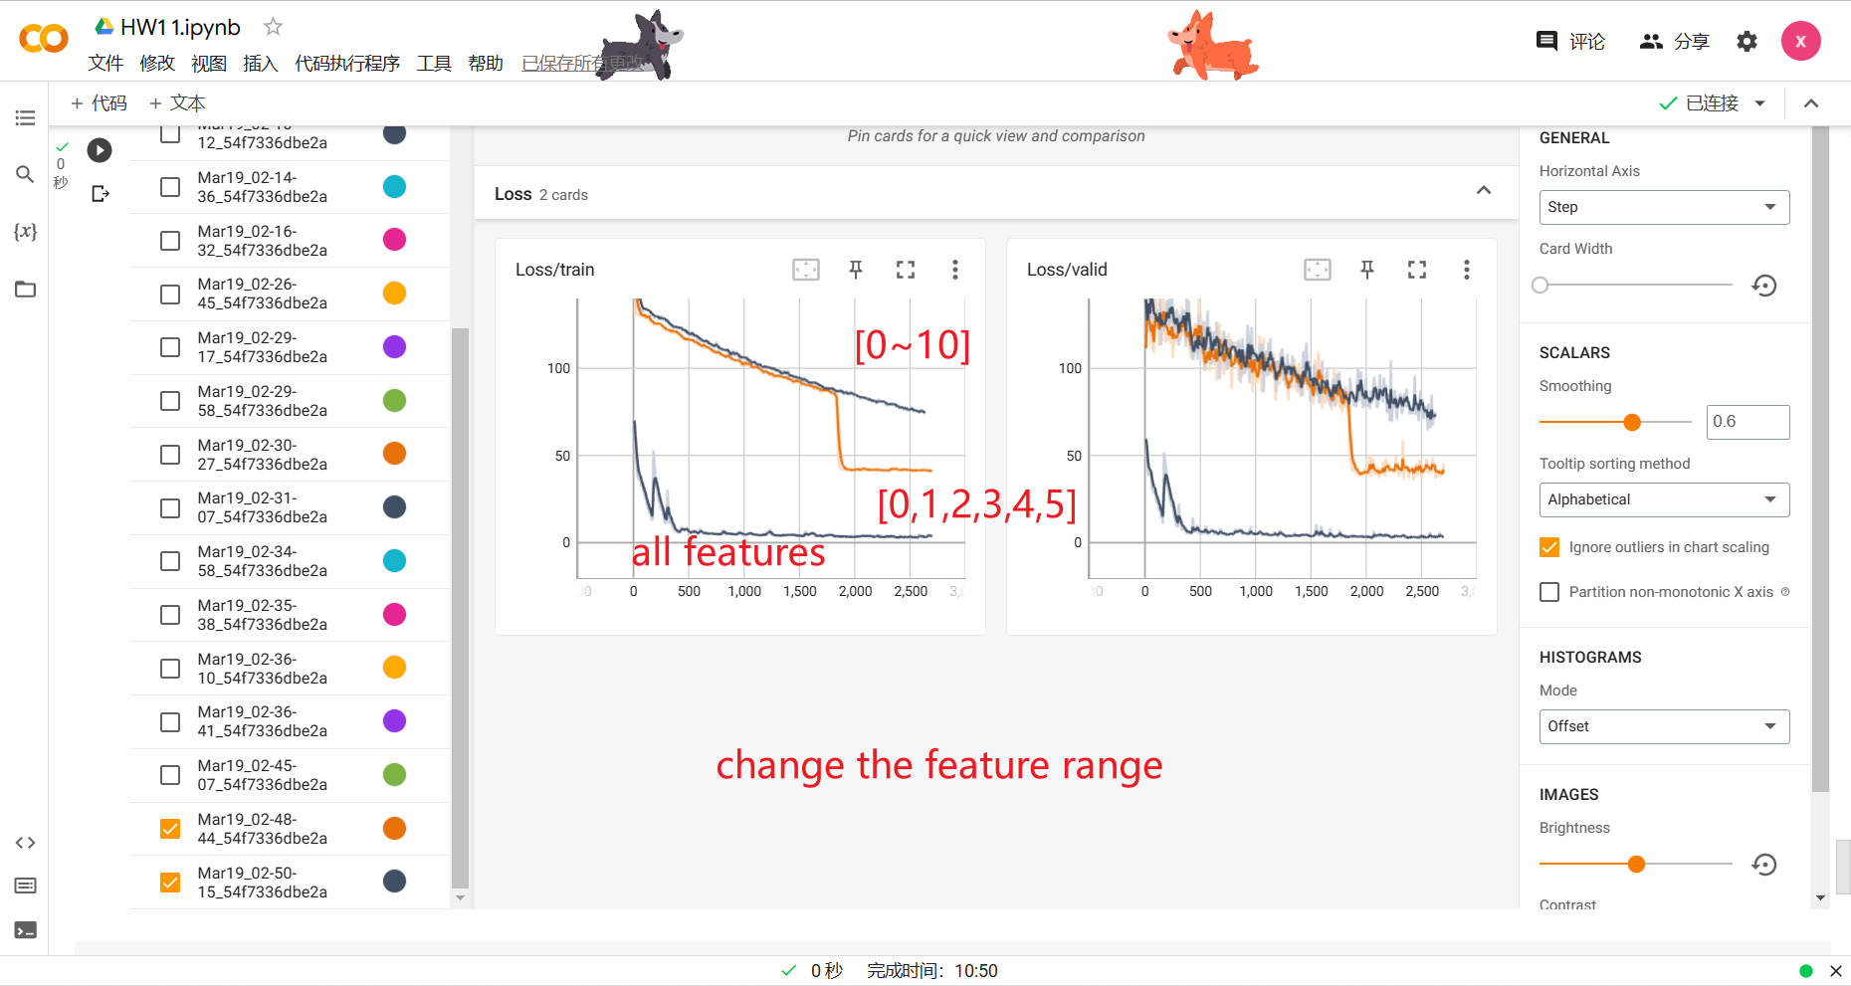

Slide 11
